Slide 1
Fall Risk Reduction Program Determining When to Discharge Designing Effective Home Exercise Plans Module #5 of 6
Shelley Thomas, MPT, MBA
Dara Coburn, M.S., CCC-SLP

Slide 2
Fall Risk Reduction Program: Review of Modules 1 -4
In the first module we reviewed the premise of the Fall Risk Reduction Program, including the inclusion criteria for patient selection.
The second module reviewed patient assessment
Identifying patients at risk of falling
Evaluating patients in a dual task condition to simulate “real life” situations
The third module covered how to determine which systems of balance were weakest and develop an exercise program for those systems.
The fourth module looked at IM scores and how to utilize them to establish treatment plans, how to advance exercises based on domains of challenge, and how to gauge progress through reassessment.

Slide 3
Module 5: Agenda
Discharge decision making
How to design a home exercise program
Is IM-Home right for your patient?

Slide 4
How to determine when to discharge
IM scores are not the determining factor in discharge planning.
Discharge planning should be based on the following:
Has the patient met their goals?
Has the patient reached a plateau?
Will the patient be receiving ongoing treatment?
Does the ongoing treatment provide IM?
What restrictions does the patient have regarding funding, scheduling, caregiver support?

Slide 5
Discharge Considerations
Patient’s should be re-examined based on their diagnosis, progressions, or regressions as needed to ensure we are providing the best possible service to our patients and making the best possible decisions regarding discharge.
Discharge decisions should be team based:
Physician
Nursing
Therapist
Social Workers
Patient/Patient Representative or Caregiver

Slide 6
Challenges with discharge planning
Caregiver support
How much time can caregivers allot for assistance with an HEP
Caregiver and patient understanding of home exercise plan
Medical Status
Discharge disposition
Concomitant medical diagnosis
Access to equipment
Access to follow-up treatment

Slide 7
Barriers to Compliance with HEPs
Barriers other than motivation predict post discharge exercise participation
Need to address barriers when developing HEP
Study that reviewed 556 adults >65 years of age were surveyed about HEP participation
37% no longer performed HEP
Forkan, R., Pumper, B., & Smyth, N. (2006). Exercise adherence following physical therapy intervention in older adults with impaired balance. Physical Therapy, 86(3), 401-410.

Slide 8
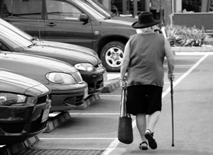
Barriers to Compliance, cont.
Reasons for poor participation:
Changes in health status (most common reason)
Lack of social support
No place to exercise, no transportation to exercise site, and insufficient money to buy exercise equipment or join exercise facility
Fear of falling
Fear of an injury while exercising
Increased stress and depression levels
Increased age
Decreased health status
Lack of enjoyment while exercising

Slide 9
Establishing a Home Exercise Program
Home exercise programs should be manageable while continuing to provide enough challenge to facilitate progress.
Exercises in a HEP should continually be monitored for effectiveness and suitability.
Repetitions and appropriate challenge level are key for successful progress or maintenance of skill level (depending on goal).
Frequency and duration should be discussed prior to discharge.
Adherence to HEP will be higher if communicating with therapist or involved in group program

Slide 10
Maintenance of Gains
Skills that are practiced regularly will be maintained at peak performance levels.
Skills that are practiced intermittently will be maintained but NOT likely at the peak level of performance.
Skills that are NOT practiced at all, will NOT likely be maintained & performance may decline.

Slide 11
Systems of Balance
Musculoskeletal
Proprioception
Vestibular
Oculomotor
Cognition
HEP should continue to focus on weakest systems of balance
May also include exercises for the less weak systems to ensure all balance domains remain strong

Slide 12
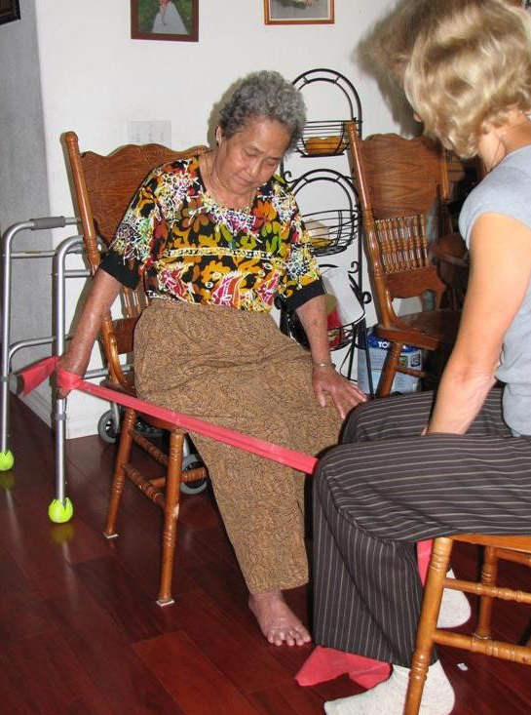
Designing Home Exercise Program
How committed is the patient?
Exercise frequency, duration
Difficulty level of exercises?
Accommodations to increase safety
Exercises for strength, flexibility, and reaction speed
If patient loses his/her balance, can she recover?
With caregiver assistance, design exercises that provoke balance reactions
BOSU ball, foam squares, unilateral stance, eyes closed
Provide adequate caregiver training
Provide clear written materials
How to perform, what equipment is needed
Advancing HEP
Return for therapy session to advance?
Provide guidelines?

Slide 13
Dual Tasking & HEP
Incorporate dual tasking into HEP
Divided attention crucial for balance, safety
Example exercises:
Stand on one foot, rotate head side to side (vestibular demand) while spelling words
Walk quickly while counting backwards from 100 by 7’s
Stroop test while marching in place or performing squats

Slide 14
Is IM-Home Right for Your Patient?
Is your patient ready to transition from IM Pro to IM Home?
Does your patient demonstrate the ability to perform the IM exercises without your clinical direct supervision and oversight?
Does your patient have strong family support and are they willing to help facilitate a HEP that includes IM Home?
Do you have limited time to see this patient in the clinic due to insurance, financial or scheduling constraints?
Does your client have a neurodegenerative disease that requires ongoing training to maintain skill level?
Is your patient and caregivers motivated to be active participants in a HEP that includes IM Home?
Does your patient have computer and internet access?
Are you comfortable setting up an HEP that includes IM Home and continuing ongoing management of that program?

Slide 15
IM-Home
INCLUDES:
IM-Home Unit with USB Cord & Software CD
Wireless Button Trigger, Hand Glove & Tap Mat
Wired Headphones
1 year manufacturer warranty
Unlimited use by one student or patient (additional licenses may be purchased for other family members)
PREREQUISITE: You must be IM-certified and your facility must own/rent the IM Pro equipment to be eligible to provide IM-Home training for your students & patients.

Slide 16
IM-Home Features
Auto/Virtual Train (assigned thru eClinic) & Manual Mode
Assessments
Everything can be modified to individualize the program
Reports
Fun Wallpapers
You are in control: Provider has the ability to suspend/disable the account if necessary

Slide 17
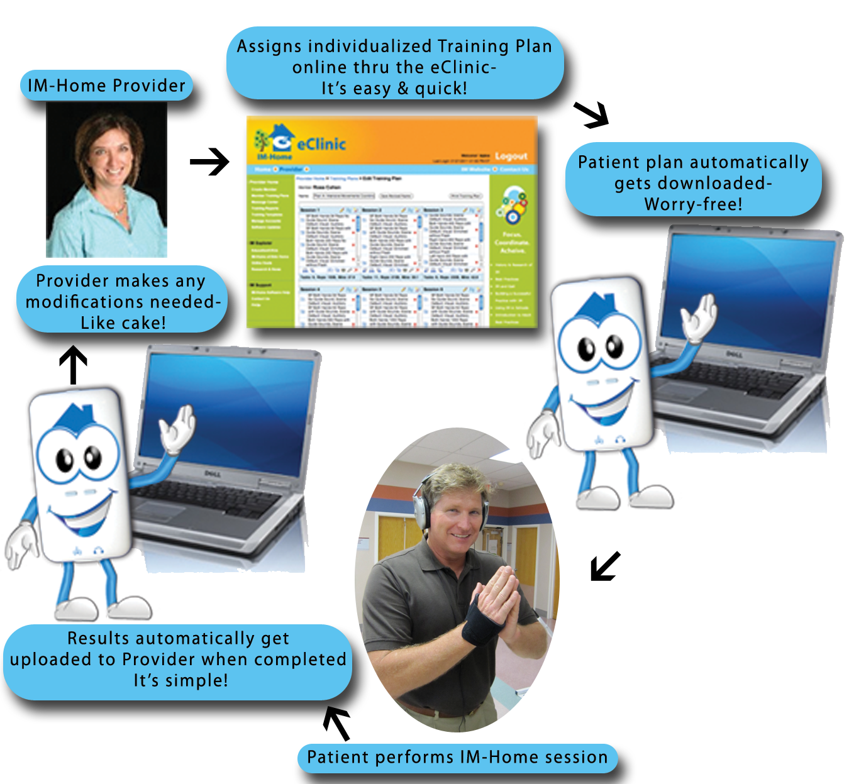
IM-Home eClinic

Slide 18
IM-Home eClinic Prescribe & Modify Training Plans
Using pre-designed templates makes creating
training plans quick & easy
View of an assigned training plan
Controls to adjust settings for a task

Slide 19
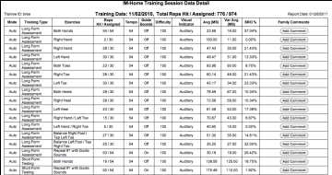
eClinic View Reports
Same Reporting Features as IMPro
Calendar View with task details & give the family the opportunity to add qualitative notes

Slide 20
eClinic Send Messages

Slide 21
Upon completion of this course, participants will be able to:
Confidently set-up and use the IM-Home training system;
Determine which tool in the IM System (IM Pro, IM-Home, or a combination) is appropriate for each client based upon unique cognitive, communicative, social/behavioral, and/or motor concerns as it pertains to developmental and acquired neurological disorders;

Slide 22
Perform & interpret objective IM-Home assessments competently;
Create & execute individualized virtual IM-Home treatment plans while working from existing templates for efficiency;
Utilize the IM-Home client management tool (eClinic) to assign training plans, view reports and communicate with clients/caregivers;
Identify opportunities to facilitate care while successfully expanding an existing practice, achieving clinical success & profitability

Slide 23
Reimbursement for Services with IM-Home
FREE Webinar: Ensuring Clinical Success & Profitability with IM-Home
fundamentals of business planning
target patient population
options for providing training to the patient
managing and tracking costs
how to price the IM Home
cash and insurance billing

Slide 24
Homework
Complete worksheet provided on materials page to design home exercise plan at appropriate challenge level for your patient. Use the same patient as in Module #2 and #3.

Slide 25
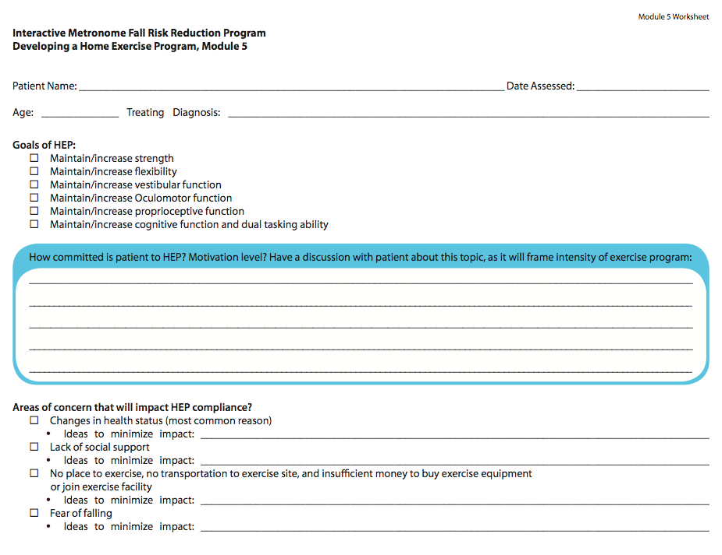

Slide 26
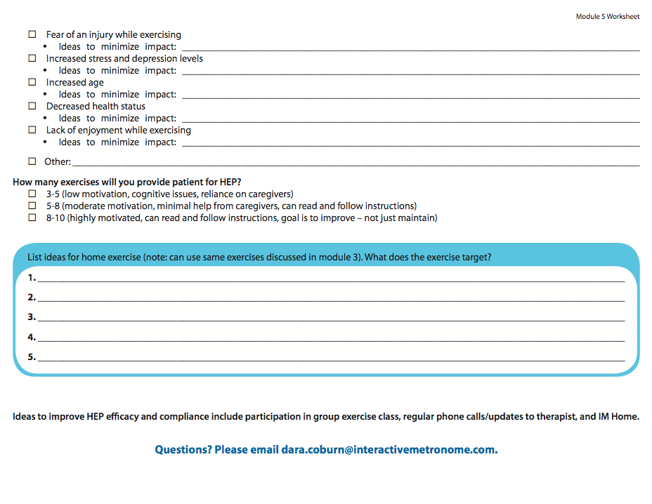

Slide 27
Post-test
Complete post-test to receive link for Module # 6 of 6

Slide 28
Materials Page
This video
PowerPoint
Developing a Home Exercise Program Worksheet
www.interactivemetronome.com/index.php/fall-risk-coaching

Slide 29
QUESTIONS? You can call or email us. We’re here to help!
Call 877-994-6776:
Opt. 3 – Education
imcourses@interactivemetronome.com
Opt. 5 – Technical Support
support@interactivemetronome.com
Opt. 6 – Clinical Support
clinicaled@interactivemetronome.com
Opt. 7 – Marketing
newsletter@interactivemetronome.com

