Slide 1
Fall Risk Reduction Program
Overview & Rationale
Module #1 of 6
Shelley Thomas, MPT, MBA
Dara Coburn, M.S., CCC-SLP

Slide 2
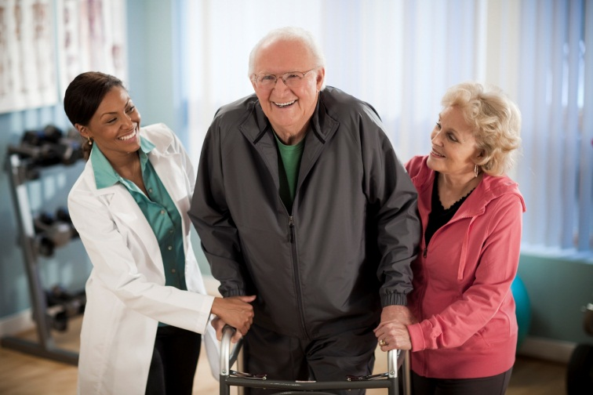
What is the Fall Risk Reduction Program?
Involves using the Interactive Metronome technology as a tool to identify and treat people at risk for falling
Identify individuals with decreased motor control and ability to dual task
Practice dual tasking by combining cognitive and balance tasks
Decrease fall risk by improving both balance and divided attention

Slide 3
What to Expect From this Coaching Series?
Module 1: Overview of Fall Risk Reduction Program
Module 2: Patient selection & assessments
Module 3: How to design exercise programs: Systems of balance, exercise selection, and domains of challenge
Module 4: Advancing the exercises
Module 5: Designing effective home exercise programs and determining when to discharge the patient
Module 6: Case study

Slide 4
AGENDA
Introduction to the Fall Prevention Protocol
History and Research Review and Rationale
Ins and outs of patient selection
Q & A

Slide 5
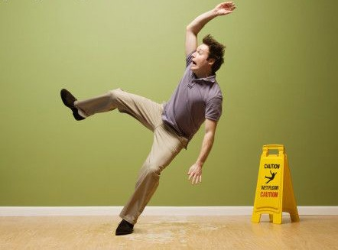
Fall Statistics
According to the CDC:
Each year, 1 in 3 adults age 65 and older falls.
Among older adults (65 and older) falls are the leading cause of injury death.
In 2010, 2-3 million nonfatal fall injuries among older adults were treated in emergency departments and more than 662,000 of these patients were hospitalized.
In 2010, the direct medical cost of falls, adjusted for inflation was $30 billion.
www.cdc.gov/homeandrecreationalsafety/falls/adultfalls.html

Slide 6
Fall Statistics
Hip fractures accounted for about 1 in 8 injurious fall-related ED visits among the elderly.
Among the elderly, patients seen in the ED for injurious falls and subsequently admitted to the hospital were more likely to be discharged to LTC than ED patients admitted to the hospital with other conditions (65.7 percent versus 28.4 percent).
Fall-related ED visits associated with fractures and internal organ injuries resulted in hospitalization (51.3 percent and 62.7 percent, respectively) and discharge to LTC (40.9 percent and 33.2 percent, respectively) more frequently than fall-related ED visits associated with other injuries.
The most common reasons for injurious fall-related ED visits among the elderly were fractures (41.0 percent), followed by superficial/contusion injuries (22.6 percent) and open wounds (21.4 percent).
www.hcup-us.ahrq.gov/reports/statbriefs/sb80.pdf

Slide 7
Fear of Falling
Self Limit Activities
Reduced Mobility & Fitness
Increase Risk of Falling
Fall

Slide 8
How can IM impact this cycle?
Interventions need to address physical fitness, motor planning and sequencing, and automaticity of movement.
Incorporating Interactive Metronome into your treatment plan helps address these elements.

Slide 9
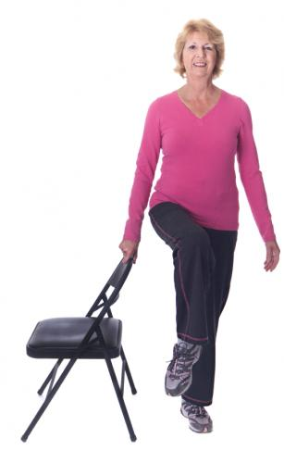
Dual Tasking Research
Balance and walking were once considered automatic activities that required minimal executive attention
Dual tasking research suggests balance and walking are not separate processes from executive attention
How walking is affected in a dual-task setting is an indicator of attentional resources or capacity for cognitive loading while walking
(Faulkner, et. al., 2007; Beaucher, et. al., 2005; Chen, et. al., 1996)

Slide 10
Balance Strategies by Population
Young, Healthy | Older, Healthy | Older, Cognitively Impaired
“Posture First” Postural stability actually improves during a dual-task setting vs. balance only. (Resch, 2011) As complexity of the tasks increase performance decreases in cognitive task. | Posture First Greater decline in Cognitive Performance Decline in Visual Spatial | Loss of Posture First Equal decline in: Balance Cognition (Woolacoot, 2002)
Notes:
Young Healthy: Response times to cognitive tasks are slower in standing vs. sitting.
Older, healthy: decline in visual is explained by phenomena that as we age, we use vision more, hence greater competition than in younger subjects.
Older, cognitively impaired: Equal decline in cognition and balance. Maintaining postural stability requires greater percentage cognitive resources. When performing a secondary cognitive task subjects have significant increased postural sway.

Slide 11
Gait Strategies by Population
Young, Healthy | Older, Healthy | Older, Cognitively Impaired
Automatic activity Speed Stride Length Double Supp. Phase when paired with cognitive task. Cognitive task performance is accurate Balance is maintained (Serene, 2005) | Automatic activity Speed Stride Length Double Supp. Phase when paired with cognitive task. Cog performance by 20% Obstacle avoidance (Al-Yahya et al. 2011) | Automatic activity Speed Stride length Double Supp. Phase when paired with cognitive task. Cognitive performance: Inaccurate Loss of Posture First Strategy
Notes:
Young, healthy: gait maintained at greater than 90% performance during dual task activities. Changes in gait demonstrate safety mechanisms to maintain balance.
Older, healthy: when compared to younger population, decrease in gait and cognitive performance. Combined motor/cognitive task, demonstrated 20% decrease in gait performance.
Older, cognitively impaired: greater decrease in balance vs. age matched control groups. Equal decline in cognitive and gait parameters. Performance can be a predictor of future falls.

Slide 12
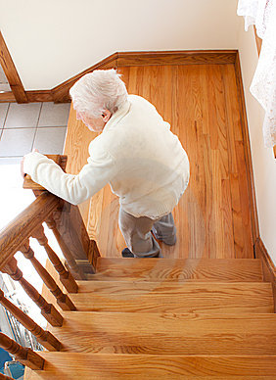
Additional Dual Tasking Research
Ojha, H. A., Kern, R. W., Lin, C.J., & Winstein, C. J. (2009, October). Age affects the attentional demands of stair ambulation: Evidence from dual-task approach. Physical Therapy , 89(), 1080-1088.
Older adults had increased difficulty handling an attentional task on stairs as compared to younger adults.
Plummer-D'Amato, P., Shea, G., & Dowd, C. (2012, April). Motor versus cognitive dual-task effects on obstacle negotiation in older adults. International Journal of Therapy and Rehabilitation, 19(4), 200-207.
This study compared the impact of a motor vs. cognitive dual task in obstacle negotion. Results indicate a motor task (coin handoff) has a greater impact on obstacle negotion than speech tasks.

Slide 13
Additional Dual Tasking Research
McGough, E. L., Kelly, V. E., Logsdon, R. G., et al. (2011, May). Associations between physical performance and executive function in older adults with mild cognitive impairment: Gait speed and the timed "up and go" test. Physical Therapy , 91(8), 1198-1207.
Physical performance speed was significantly associated with executive function in older adults with mild cognitive impairment.

Slide 14
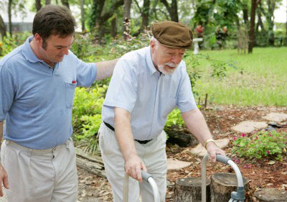
Rational for Assessing Dual Tasking
Impaired ability to maintain normal gait while performing other cognitive tasks, may predispose individuals to postural instability while walking and to falls by reducing obstacle avoidance and ability to recover from a postural perturbation independent of neuromuscular function
(Chen, et. al, 1996; Brown, et. al., 1999; Faulkner, et. al., 2007)

Slide 15
Dual Tasking & Impact of Age
Effective treatment interventions need to increase attentional resources as well as balance reactions

Slide 16
Movement Requires
Directed attention
Changes in muscle length over time; (motor control and timing are intimately related)
Muscle activations require timing on the order of tens of milliseconds
Pathologies that disrupt motor timing and sequencing lead to inaccurate movements (Mauk & Buonamano, 2004).

Slide 17
IM & Dual Tasking
IM requires a patient to focus on auditory stimuli and make a motor response to hit the trigger on the beat.
Must decide if need to slow down, speed up, or remain consistent.
Can use auditory or visual feedback to guide performance.
Computer can measure performance in milliseconds, so act at same speed as muscular contractions.
Helps patients identify their own timing tendency and learn how to counteract own tendencies.

Slide 18
A Team Approach
Born out of interdisciplinary committee recognizing that each discipline can help identify the root cause of conditions that contribute to fall risk.
PT, OT, ST members on committee
Utilizes traditional exercises that have been shown to impact balance systems.
Incorporate exercises with IM to get the benefit of working balance systems and timing structures simultaneously

Slide 19
REFERENCES
Ojha, H. A., Kern, R. W., Lin, C.J., & Winstein, C. J. (2009, October). Age affects the attentional demands of stair ambulation: Evidence from dual-task approach. Physical Therapy , 89(), 1080-1088.
Owens, P. L., Russo, A., & Spector, W. (2009, October). Emergency department visits for injurious falls among the elderly, 2006. Agency for Healthcare Research and Quality: Healthcare Cost and Utilization Project, 80(), 1-11. Retrieved from http://www.hcup-us.ahrq.gov/reports/statbriefs/sb80.pdf
Woollacott, M., & Shumway-Cook, A. (2002). Attention and control of posture and gait: A review of an emerging area of research. Gait and Posture, 16, 1-14.

Slide 20
REFERENCES
Centers for Disease Control and Prevention, National Center for Injury Prevention and Control, Division of Unintentional Injury Prevention. (2012). Falls among older adults: An overview. Retrieved from http://www.cdc.gov/homeandrecreationalsafety/falls/adultfalls.html
Chen, H.C., Schultz, A.B., Ashton-Miller, J.A. et al. (1996). Stepping over obstacles: Dividing attention impairs performance of old more than young adults. Journals of Gerontology Series A: Biological Sciences and Medical Sciences, 51 (A), 116–122.
Faulkner, K.A., Redfern, M.S., Cauley, J.A., et al. (2007). Multitasking: Association between poorer performance and a history of recurrent falls. Journal of the American Geriatrics Society, 55 (4), 570-576.
Mauk, M. & Buonomano, D. (2004). The Neural Basis of Temporal Processing. Annual Review of Neuroscience, 27, 307-340.

Slide 21
”Optional Homework"
Optional, but highly encouraged
The remaining five modules will contain a worksheet to design an fall reduction care plan for your patient.
We recommend watching some additional webinars to further understand how to incorporate Interactive Metronome into your plan of care

Slide 22
Recommended Webinars
Introduction to Adult Best Practice
Use of IM to improve functional mobility with neurologically impaired adults self-study.
Movement, executive function and the IM self-study.
Integrating IM and traditional therapy techniques self-study.
Using IM in skilled nursing facilities.
Enhancing stroke rehabilitation outcomes with IM self-study.

Slide 23
Post-test
Complete post-test to receive link for Module # 2 of 6

Slide 24
Materials Page
This video
PowerPoint
Optional Webinar Registration Links
www.interactivemetronome.com/index.php/fall-risk-coaching

Slide 25
QUESTIONS? You can call or email us. We’re here to help!
?
Call 877-994-6776:
Opt. 3 – Education
imcourses@interactivemetronome.com
Opt. 5 – Technical Support
support@interactivemetronome.com
Opt. 6 – Clinical Support
clinicaled@interactivemetronome.com
Opt. 7 – Marketing
newsletter@interactivemetronome.com

