Slide 1
CERTIFICATION & COACHING:
IM PEDIATRIC BEST PRACTICES
MODULE 9: Use of Interactive Metronome Systems in a Group Setting
By Mary L. Jones, OTR/L, DipCOT
Sensational Kids, LLC
Brain Focus International, Inc.

Slide 2

Learning Objectives for Module 9
Homework assignment review and post-test from previous session.
The Business of Running Groups
Provider competency in preparation for running IM Groups
Group considerations for use
of IM
Media examples
Review of Session 9
Assignment/Homework

Slide 3
Review of Post-Test from Module 8
1. True or False: It is not necessary to complete a short form test with infants
Answer: True

Slide 4
Review of Post-Test from Module 8
2. True or False: Use of IM with infants and children with decreased cognitive capacity should be structured in a program template.
Answer: False

Slide 5
Review of Post-Test from Module 8
3. True or False: There is no benefit in completing hand over hand assistance during IM training
Answer: False

Slide 6
Review of Post-Test from Module 8
4. True or False: When focus is significantly impaired, it is permissible to set the IM session with high repetitions and working on moving in and out of the beat to attain ‘pockets’ of focus.
Answer: True

Slide 7
Review of Post-Test from Module 8
5. True or False: During IM training with this population, it is a good idea to have multiple activities on hand to incorporate into IM tasks.
Answer: True

Slide 8
The Key to IM Success:
Modify for Engagement!
Be Spontaneous for Novelty!
Increase repetition for
Synaptic growth!

Slide 9
Techniques for Success
Positioning alternatives
Physical Environment
Sensory Environment
Motivation Strategies
Tempo/Timing variance
Feedback Strategies
Interpreting Data
Pacing of activities and themes
Duration of tasks and sessions
Building Relationships – allowing control
Switch choices and Access

Slide 10
Group IM – what a great idea!
Progressing your own skill levels from individual IM training to group interventions.
Understanding the ‘whys’ and the ‘why nots’ of group IM set up.
Acquiring the tools and resources needed for effective group IM sessions.

Slide 11
Student Skill Criteria for Group Selection
Be able to follow simple directions
Demonstrate emerging social skills
Demonstrate task relevant sensory integration skills.

Slide 12
Developing professional competency in preparation for IM group leadership
Associate to the beat in order to effectively tune in with and facilitate others accurately.
Identify and problem solve IM proficiency in students ‘in the moment’
Identify and problem solve group dynamics within student performance and manage ‘in the moment’
Recognize your own professional capabilities and comfort zones.
Notes:
Associate to the beat in order to effectively tune in with and facilitate others
Identify and problem solve IM proficiency in students ‘in the moment’
Identify and problem solve group dynamics within student performance and manage ‘in the moment’
Recognize your own professional strengths and areas of weakness and plan groups not only to meet the needs of students, but also to meet your own capabilities

Slide 13
Group Considerations: Professional Set up
Tempo
Volume
Headphones versus speakers
Mode: auditory/visual/both
Performance structure: task average/ burst threshold/ left screen/ right screen
Game play/activities
Number of players
Equipment and trigger choices

Slide 14
IM Group Analysis - 1
Movie: Slide 14-16 - Turn taking.mp4
Notes:
Slide 14-16 - Turn taking.mp4

Slide 15
Group Considerations: Assess the Following …
Physical abilities and access
Cognitive capacity
Emotional intelligence
Individual backgrounds/history
Sensory interpretation, adaptation and regulation skills
Notes:
***awareness of any bullying or abuse situations

Slide 16
IM Group Analysis – 2
Movie: Slide 14-16 - Turn taking.mp4
Notes:
Slide 14-16 - Turn taking.mp4

Slide 17
Student Dynamics:
Skills Involved in Group IM
Mindfulness, presence and understanding, cooperation
Turn-taking, pragmatic engagement
Predicting, planning and problem solving
Peer pressure and peer review
Contextual eye-contact
Waiting, achieving, failing, seeking help

Slide 18
Peer support with multiple switch activity
Movie: Multiple switch turn taking.mp4
Notes:
Multiple switch turn taking.mp4

Slide 19
Student Dynamics:
Positive Observations
Listening skills
Leadership experience
Team building skills (the ability to follow)
Decision making
Appropriate use of humor and pragmatic language

Slide 20
Turn Taking with Siblings
Movie: Turn-taking during IM training.mp4
Notes:
Turn-taking during IM training.mp4

Slide 21
Student Dynamics: Significant Observations - Sensory
Increased signs and symptoms of sensory overload – breathing; blinking; ticks; oral motor overflow; skin color; fidgeting; volume; posture; facial grimacing; itching; eye aversion; fluidity of movement.

Slide 22
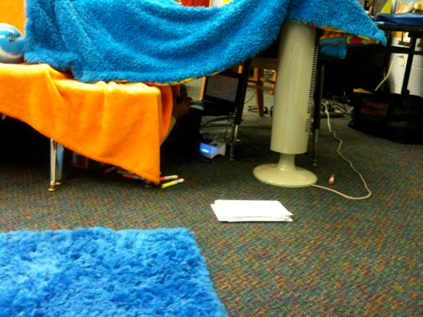
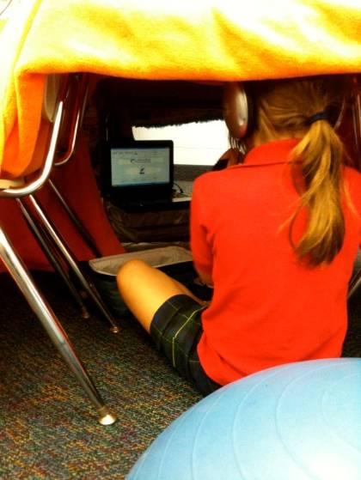
Group IM in the
School Setting

Slide 23
Embracing IM Groups – 1
Extend group practice into individualized IM training:
  a) Family members
  b) Peers
  c) Friends (i.e. IM pizza party!)

Slide 24
Embracing Group IM – 2
Establishing a Group IM Program:
  a) Rhythm and beat for infants and toddlers
  b) Focus groups for school aged students
  c) Summer curriculum programs.

Slide 25
The Business of Running Groups
More clients have access to IM training
Keep down waiting lists
Maximize therapists interventions in ‘prime’ time slots
Build IM-Home programming by example
Bring down the cost of IM training
Utilize therapy assistants and fieldwork students

Slide 26
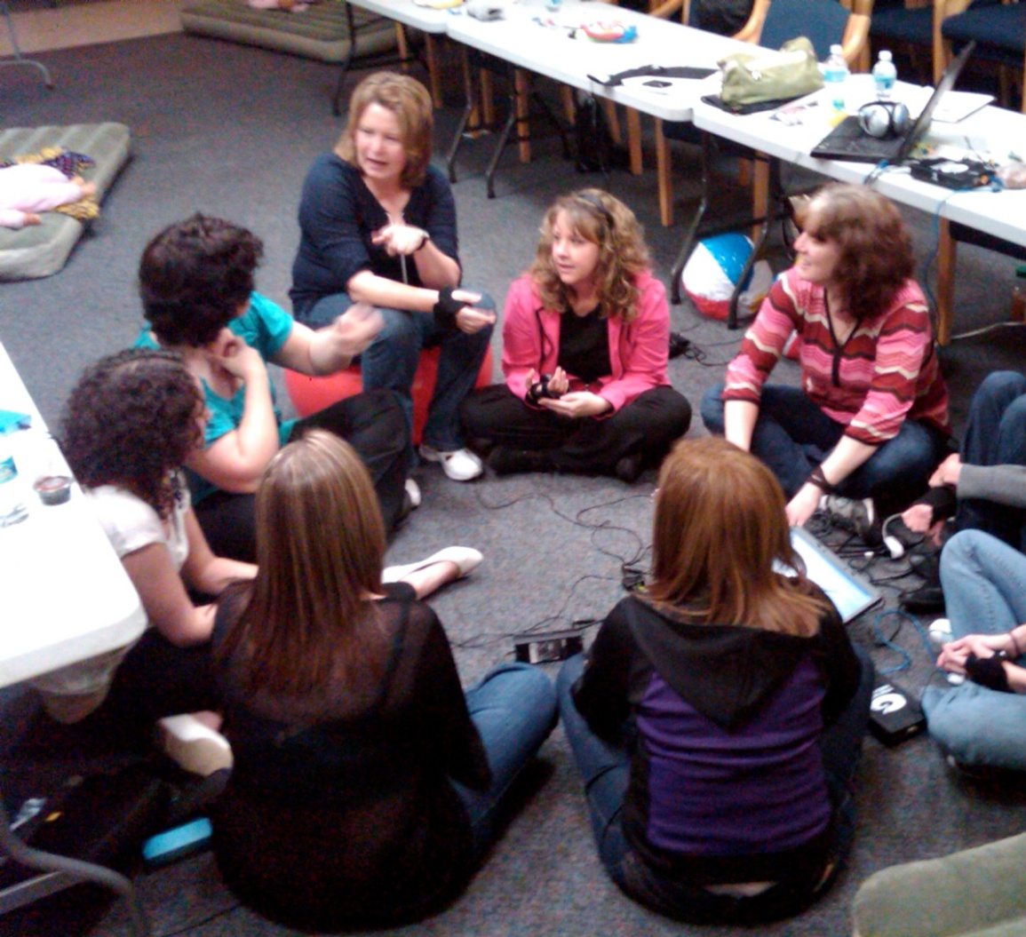
IM Group CSI…
What is happening in this picture?
Who’s leading?
Who’s following?
Who’s attending?

Slide 27
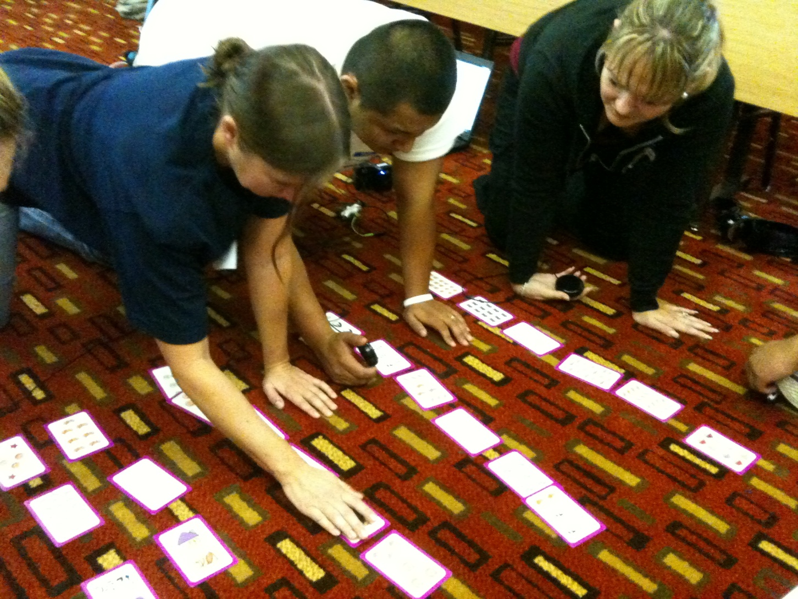
IM Study Group

Slide 28

Review of Module 9 Learning Objectives
Group considerations using Interactive Metronome®
The business of running groups
Provider competency in preparation for running IM Groups
Media examples

Slide 29


Slide 30
Module 9 Homework
Complete Post-Test
Complete Module 9 Worksheet

