Slide 1
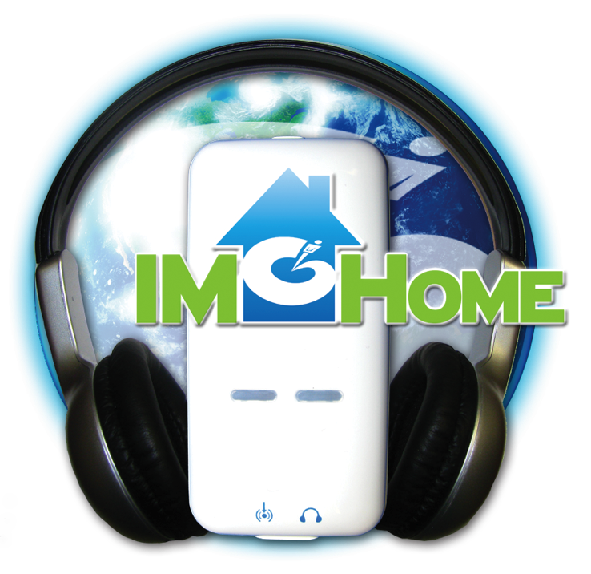
IM-Home Certification Coaching Course 2 of 2
Presentation by: Sherrie Hardy
Hardy Brain Training • Camarillo, CA

Slide 2
Agenda
Identifying your clients goals
Ratings & Assessments
Shifting from Office to Home
Scheduling your clients IM-Home sessions
Motivational strategies
How to Charge
How to Market

Slide 3
Materials you received today
Rating Scales
Rating Comparison
Sensitive Assessment Instruments List
Medical History
Scheduling Chart
Cooperation Chart
Ratings Journal
Certificate of Completion
Materials can be downloaded from:
http://imhome.org/index.php/home-specialist-coaching

Slide 4
Materials you received today
Marketing Materials
Screening Form with Pricing
What is the Cost of a Changed Life?
Developmental Milestones
What is IM’s Secret Ingredient?
Materials can be downloaded from:
http://imhome.org/index.php/home-certification-coaching

Slide 5
Your IM-Home Self-Training
How did your training go?
Are you comfortable with the eClinic?
If you need technical help contact support@interactivemetronome.com

Slide 6
Identifying Your Clients Goals
What does your client want their life to be like in the end?
Your role as a Provider is to help them create success
Notes:
Sherrie give client example

Slide 7
Rating Scale: Social/Emotional
Difficulty making eye contact
Difficulty with emotional control
Difficulty making/keeping friends
Lack of Self Confidence
Low Frustration Tolerance

Slide 8
Rating Scale: Language
Difficulty with communication
Poor phonics
Poor initiation of reading/does not read to self or aloud
Poor spelling skills
Poor Reading Comprehension

Slide 9
Rating Scale: Physical/Motor
Has a “floppy” or “rigid” posture
Poor sense of Rhythm
Poor handwriting/fine motor skills
Poor Eating Habits
Poor Hand/Eye Coordination

Slide 10
Rating Scale: Sensory
Sensitive to sound - noises
Sensitive to touch – others touching self
Sensitive to particular foods
Sensitive to movement
Sensitive to visual input

Slide 11
Rating Scale: Attention/Organization
Poor task initiation
Poor sequencing when completing a task
Poor Auditory Attention
Poor Visual Attention
Poor overall organization, especially before and after school

Slide 12
Pre, Mid & Post Ratings Scale Worksheet
Gauge where your clients are pre, mid and post IM training.

Slide 13
Medical History

Slide 14
Standard Assessments
Use discipline specific tests before/after IM to determine functional progress

Slide 15
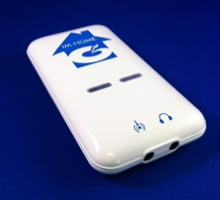
How to make IM-Home work with your clients

Slide 16
Office to Home Consultation
When ready to shift to home set up a meeting with the parents/caregivers
Review progress to date
Review why you think the client is ready to shift to home
Review what schedule might be best for the client and the family
Help parents complete the IM home schedule before they end the meeting.

Slide 17
Shifting IM from office to home
Help identify the best space for doing IM
Help parents identify the best schedule for the shift to home: For example
First week-2 sessions in the office, 1 at home
Second week- 1 session office, 2 at home
Third week-All IM sessions at home with ½ hr consult from IM provider

Slide 18
Lock down schedule with family

Slide 19
IM-Home & IM Pro are eClinc compatible!
Train @ home or in the clinic and your data will remain intact!

Slide 20
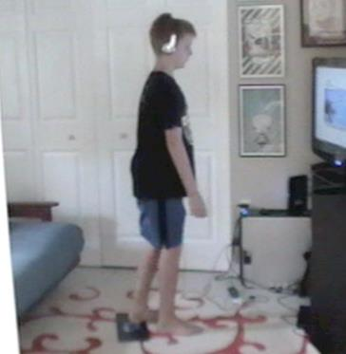
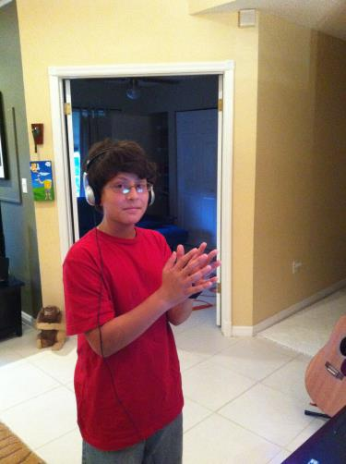
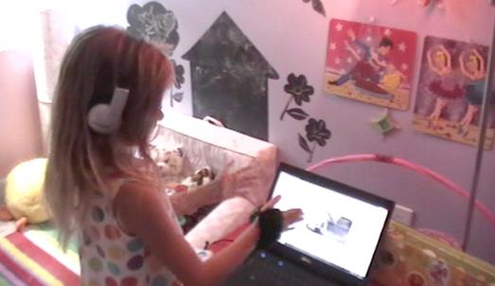
How to motivate your client in the home setting

Slide 21
Help parents motivate their child
Identify rewards for completing IM Sessions
Less is more
What is the smallest level of “buy-off”?
Words of encouragement count
Post best ms, # of burst or IAR somewhere he can see
Never use food as a reward
Point/token system towards a larger prize
Treasure box
Do a family weekly reward
Sprinkle in surprises

Slide 22
Help Parents Stay Motivated
Give parents tools for helping their child master training
Narrow down choices for child
Help parents recognize child’s progress
Review training results
Recognize independence
Illustrate to parents the benefit of using IM equipment forever
Before a big test
Before a sporting event

Slide 23
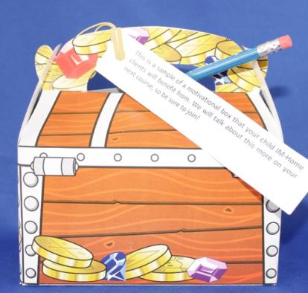
Motivational Package

Slide 24
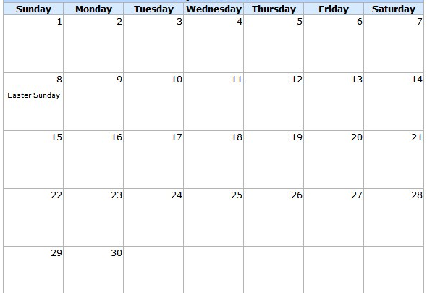
Cooperation Chart

Slide 25
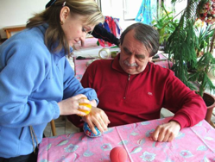
Keeping your adult clients on track
Be aware of each increment of progress & talk about it- they like to be recognized!
Coordinate with other therapy professionals about the “Big View” Goals

Slide 26
Ratings Journal

Slide 27
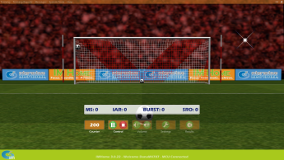
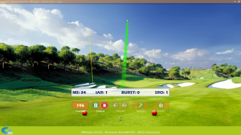
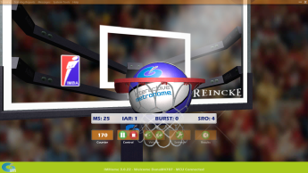
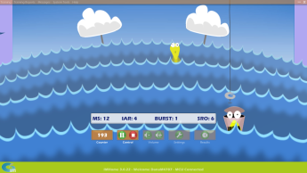
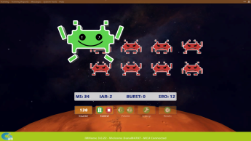
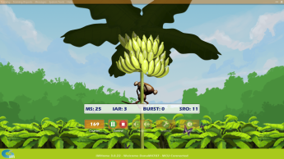
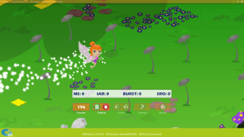
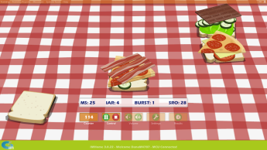
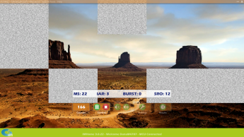
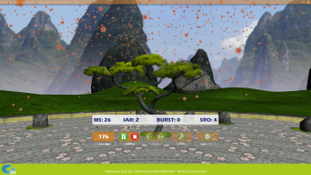
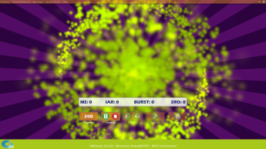
IM Universe Worlds

Slide 28
Certificate of IM-Home Completion

Slide 29
How to charge
Cost per sessions | # of sessions | Total Cost of IM/IM-Home Program Consultation | Time it takes you all in-clinic | Time it takes you all in-home
$50 | 32 | $1600 | 32 hours | 10-20 hours
$100 | 32 | $3200 | 32 hours | 10-20 hours
$150 | 32 | $4800 | 32 hours | 10-20 hours
Equipment Cost
$599 IM-Home Equipment
$199 Additional License
**Plus Your Clinical Fees**

Slide 30
How can I charge my client That much?
A plumber spends 10 minutes fixing a pipe and hands the woman a bill for $100.
The woman is shocked by the bill and asks why it’s so much, it only took him 10 minutes.
The plumber replies, why yes, but it took me 20 years to know exactly where to hit that pipe so it doesn’t blow-up and flood your house!
YOU ARE WORTH IT!!
DIDN’T YOU GO TO SCHOOL TO LEARN A SPECIFIC TRADE?
YOU ARE THE EXPERT & THAT’S WHY YOUR SERVICES ARE VALUABLE

Slide 31
Profit & Success Webinar
Target patient population
Options for providing training to the patient
How to manage and track costs
How to price the IM-Home
How to bill, including cash and insurance billing.

Slide 32
How do I market IM-Home?
Demo IM-Home to current clients*
Hold Free Screenings for new clients
Package IM with other modalities
Market on Social Media- Join our FB Tribes and interact with potential clients
Collateral we have created for you:
IM-Home Brochures
What is the cost of a Changed Life?
Developmental Milestones
What is IM’s Secret Ingredient?
Screening Form with Pricing
Ads

Slide 33
OFFER FREE SCREENINGS TO GET PEOPLE IN DOOR

Slide 34
Business Development Tool Kit
Watch Marketing 101 videos and learn what it takes to build a successful practice.
Promote your IM services with professionally made video clips and news clips. All you have to do is cut and paste the code into your website. It’s easy and will be a sure-fire way to get clients into your door, so you can help them make the gains they dream about.
Make your mark on the web! Choose from wallpapers to decorate your desktop, banners to advertise on your website and email campaigns to drive people to your door.
Check out the numerous flyers, brochures, postcards, referral cards and banners to hand out or display at a tradeshow. Choose from IM stock images and logos to customize your marketing pieces.
Social media provides an opportunity to reach clients and professionals on a personal level. It’s time to get your business on the social sphere so you can communicate your mission in this manner. Get started today.

Slide 35
Homework
Log into Provider website and view business development tool kit
Billing, Marketing, Motivation
Take online post-test to be listed as IM-Home Certified on the Locator Board

Slide 36
Questions
Clinical Support
clinicaled@interactivemetronome.com
Technical Support
support@interactivemetronome.com
Education Support
imcourses@interactivemetronome.com

