Slide 1
IM-Home Specialist Certification Course 2 of 2
Presentation by: Sherrie Hardy
Hardy Brain Training • Camarillo, CA

Slide 2
Agenda
Evaluating client progress and adjusting the training plan
Case Analysis
Let’s talk about your client

Slide 3
Surprise!

Slide 4
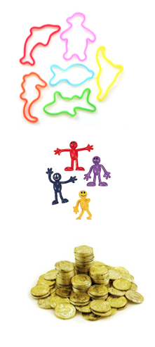
Motivational Package

Slide 5
Phillip- 10 yrs Autism Spectrum

Slide 6
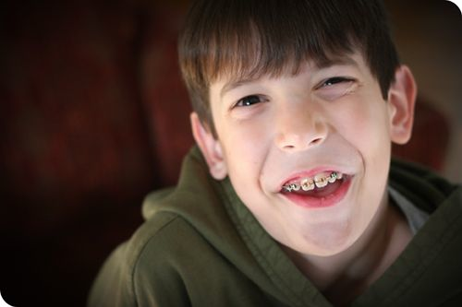
Case Study Analysis Phillip
Observations (First 3 sessions):
Easily frustrated trying to coordinate his hand movements
Difficulty making continuous circles
Occasionally dropped down on the floor
Both hands: 296 - 259
Right hand: 273 -245
Left Hand: 310 -290
CHANGES: Customize the tempo to a faster speed (try somewhere between 80 and 100 at first and observe his progress). Continue hand over hand. Experiment with tapping the tap mat on the table.

Slide 7
Lesley- 13 yrs Struggling in school (especially reading), attention problems, disorganized, difficulty completing school assignments

Slide 8
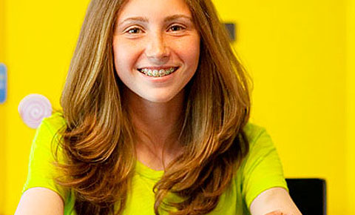
Case Study Analysis Lesley
Both hands: 120 - 75
Right hand: 93 - 63
Left hand: 110 - 90
CHANGES: During week 2 guide sounds will get louder, difficulty will change from 200 to 100 and feet will be introduced on day 10. Stand next to Lesley and tap to the beat to help her coordinate her feet.

Slide 9
Cliff- 67 yrs plays golf, feels less organized, mental focus has declined, more difficulty completing tasks

Slide 10
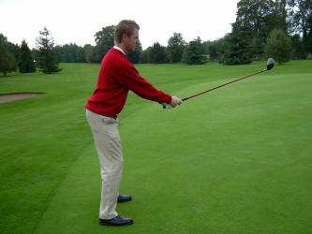
Case Study Analysis Cliff
Observations: Cliff is motivated and eager to see progress.
Both hands- 70 – 43
Right hand – 81 – 70
Left hand – 93 – 74
Both toes – 87 – 65
Right toe – 70 – 56
Left toe – 77 – 65
CHANGES: Observe Cliff’s reaction on Day 5 when the training goes to AUTO train. If this becomes frustrating, change the difficulty to 100 or to 50 ms over his average scores. On day 7, observe how he integrates feet if the program is still on auto train and adjust difficulty if necessary.

Slide 11
Materials you received today
Motivational Package
Materials can be downloaded from:
http://imhome.org/index.php/home-specialist-coaching

Slide 12
Grand Rounds- Speak up!!

Slide 13
Connect after this course with the IM Forum
http://imhome.org/index.php/forum/index.html

Slide 14
Modify Clients training plan as necessary
Remember to motivate the client and family as much as possible
Take Online Post-Test to get IM-Home Specialist designation on locator board

Slide 15
Materials you received
Motivational Box Sheet with list of contents
Materials can be downloaded from:
http://imhome.org/index.php/home-specialist-coaching

Slide 16
Questions
Coaching Support
coaching@interactivemetronome.com
Clinical Support
avega@interactivemetronome.com
Technical Support
support@interactivemetronome.com

