Slide 1
IM Pro Clinical Certification Coaching Course 1 of 2 Presented by: April Christopherson, OTR

Slide 2
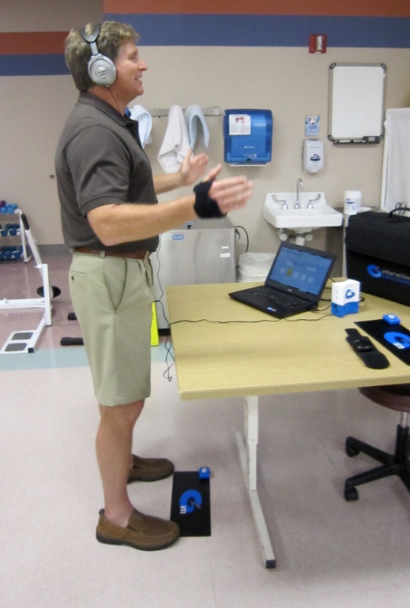
Agenda
Set-up Pro Equipment
Software interface and it's features
Review 4 Phases of IM
Evaluating the LFA
HOMEWORK!
Complete 4-day training plan sent to you in e-mail
Notes:
5
How did he get there?.....

Slide 3
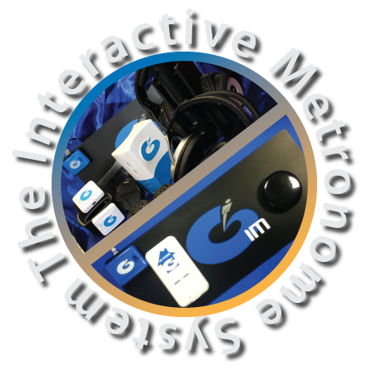
Interactive Metronome System
Software
Hardware
Master Control Unit
Button Trigger
Tap Mat
In-Motion Switch
IM-Home
Notes:
10
IM comes with each of these components.
Software will be discussed a little bit later.
Have participants quickly set up their IM with your guidance. Point out each component, what it does, and guide them through hooking up the IM. Power up the computers if not done so already.
Discuss briefly optional equipment (wireless foot, hand, and gait triggers).

Slide 4
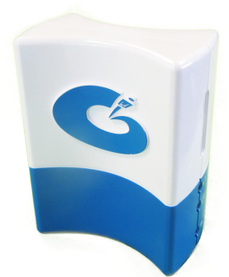
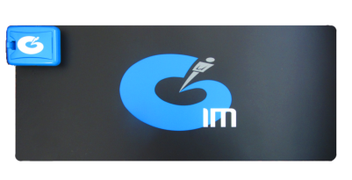
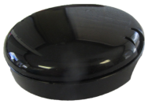
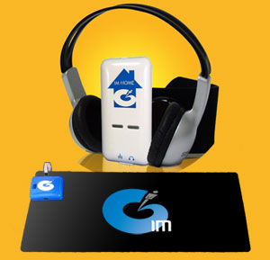
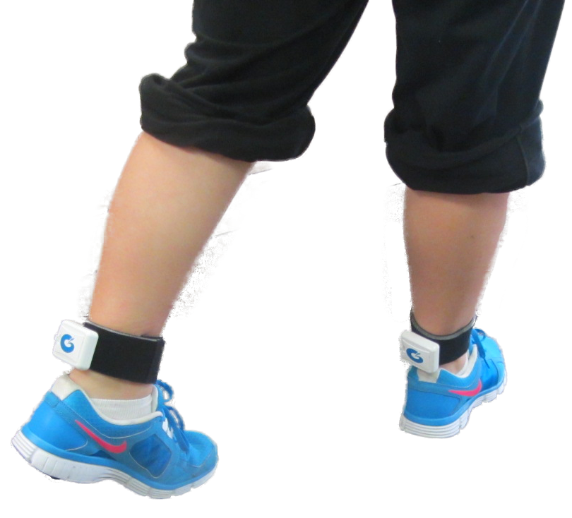
The MCU, Button Trigger & Tap Mat
IM-Home
The In-Motion Trigger Set

Slide 5
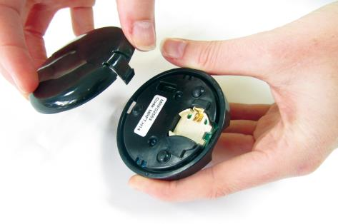
Setting Up the Equipment
Wireless Tap Mat and Button Trigger
Remove cover and insert battery on button trigger

Slide 6
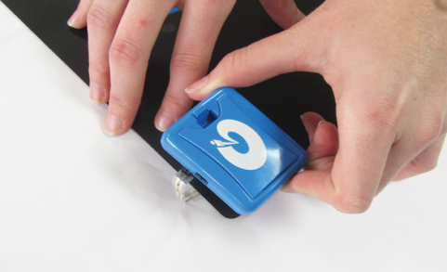
Setting Up the Equipment
Wireless Tap Mat
Remove cover and insert battery into Tap Mat. Be Careful with small cord!

Slide 7
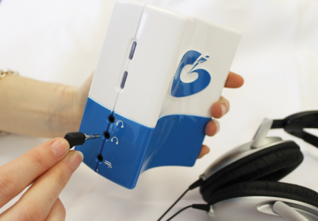
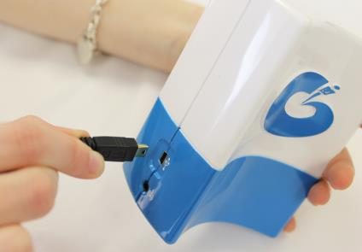
Setting Up the Equipment
Headphone port and USB Port on MCU Unit

Slide 8
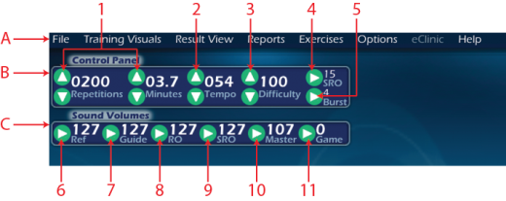
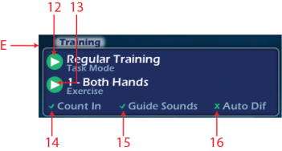
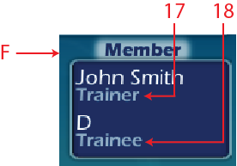
Software Features
Refer to your Self Study Manual
*Download available on course materials page
Notes:
Follow an orderly pattern.
Advise that they will do several workshops today and will be competent with navigating through the IM by the end of the day. For now, just watch you point out the features and where things are located.
FILE - Review how to make new file and open existing file
FILE – Review how to SAVE AS
FILE – Review how to CLOSE a file
TRAINING VISUALS – Review the 4 types of Indicator Screens (you may need to demo them very briefly)
TRAINING VISUALS – Go over the options and demo a few backgrounds and games (child boy/girl, adult)
RESULT VIEW – Show the options and that this is where to switch which view you will see
REPORTS – Show them this is where reports are accessed and that they will be retrieving reports throughout the day to learn how to get to them and understand them
EXERCISES – Show them this and how to select which one to view and how to close out of this.
OPTIONS – Show them that this is where they will Authorize IM Hours (they can contact IM technical support for that when needed), and that this is where they can build an avatar for their client.
TRAINING PANEL – Mode, exercise, count in, guide sounds on/off, auto diff – change to Regular Training so you can show them how to adjust settings in Control Panel
PATIENT – Review information in this panel
CONTROL PANEL – Review features. Reps, minutes, tempo, difficulty, burst threshold, and SRO range (this is a new feature that allows you to expand/narrow the SRO range)
SOUND VOLUMES – Review volumes for all IM sounds and master volume, also review how to add background sound/music for the games (demo a game with background sound)
CURRENT SCORES – Review what is seen on this screen
IM INDICATOR – Review what is seen on this screen, MCU connection, hours remaining on MCU, etc

Slide 9
Short Form Test
2 tasks to measure timing (1 min. each)
Both Hands with ref tone
Both Hands with ref tone & guide sounds
Short Form Assessment (SFA) Report
Indicator Table
Notes:
Participants should refer to image in appendix

Slide 11
What Happens in IM?
Five neurological functions exercised at once:
Controlled Attention & Concentration
Working Memory
Sensory Integration
Motor Planning/Sequencing for Coordination & Functional Motor Control
Synchronization of timing in multiple brain regions for increased neural efficiency & performance
Neuroplasticity…“What is fired together, is wired together”
Notes:
Participants will not all complete the SFT – since it is redundant to portions of the LFA.
By facilitating cortical organization through repetition and the development of new and established neural pathways, including Interactive Metronome as part of a comprehensive rehabilitation program has the potential to bridge the brain body gap and facilitate permanent functional neurological change.

Slide 12
4 Phases of IM Training
Phases 1-2 | Learn IM
Phases 3-4 | Improve Timing & Rhythm
*(See appendix page A-9)
Note: Phases are not applicable for total hands-on training (i.e., with infants, low functioning clients.

Slide 13
IM Training PHASE 1
LEARN REFERENCE TONE
Guide sounds OFF
Repeat hand exercises 1-3 until learns to try to match the beat
1-3 minutes (54-162 repetitions) per exercise
Rhythmical, circular hand movement
Cue as needed for timing & rhythm

Slide 14
Adjusting Difficulty
101+
16 – 100
0 – 15
16 – 100
101+
201+
16 – 200
0 – 15
16 – 200
201+
0-15
301+
16 – 300
0 – 15
16 – 300
301+
0-15
25+
16 – 24
0 – 15
16 – 24
25+
0-15
Notes:
DEMONSTRATION - Demo with guide sounds on with visual mode (score) – without center flash.

Slide 15
Adjusting Difficulty
Patient’s MS Average | Suggested Difficulty Setting
More than 300 ms | 300 (easiest setting)
200 ms…………add 100 to range | 300
150 ms…………add 100 to range | 250
100 ms…………add 50 to range | 150
50 ms…………..add 50 to range | 100
Less than 25 ms | Auto (most challenging)

Slide 16
IM Training PHASE 2
LEARN GUIDE SOUNDS
Guide sounds ON
Repeat hand exercises 1-3 until learns to respond to guide sounds
2-5 minutes (108-270 repetitions) per exercise
Counteract timing tendency
Auditory-only or use training visuals to provide additional cues?
If working on auditory processing, use visual cues as a bridge to teach guide sounds then wean from visual cues!!
Set difficulty level
Cue as needed
Notes:
Start right at 1:30pm

Slide 17
Phase 2 Adjust the Intensity of Feedback for Timing
Performs BETTER with guide sounds | Performs WORSE with guide sounds
Adjust difficulty as appropriate to nudge patient closer and closer to SRO. | Adjust difficulty so that buzzer is heard less often.
Adjust burst threshold higher as appropriate to encourage more intense & precise focus, processing, & fine motor control. | Turn down the volume of the guide sounds so that the ref tone is the loudest sound he hears.
Increase repetitions as tolerated. | Turn volume of all guide sounds down to zero except for the one labeled GUIDE & use this as an outer boundary.
Increase SRO settings to encourage success | Turn on the visual mode to help him learn what the guide sounds mean & to respond timely and accurately.

Slide 18
IM Training PHASE 3
DEVELOP BASIC TIMING
Guide sounds ON
Repeat hand exercises 1-3 until timing & rhythm are ↑ and ms scores improve to average or better for age (compared to Indicator Table)
Aim for low 20 ms range for individuals returning to high functioning jobs, school, college
3-5 minutes (162-270 repetitions) per exercise
Software setting adjustments to nudge toward ↑ SRO
Adjust difficulty setting to narrow right-on zone
Keep trying to increase repetitions as tolerated
If working on auditory processing skills, wean from visual cues
Introduce games to motivate and engage

Slide 19
IM Training PHASE 4
GENERALIZE TIMING SKILLS
Increase focus & fine motor skills with exercises 1-3 by reducing ms scores to as low as possible
3-5 minutes (162-270 repetitions) per exercise
Adjust Difficulty to nudge closer to SRO
Begin to stretch out one exercise to work on sustained attention
15-60 minutes depending on age/goals
Introduce lower extremity exercises 4-13
2-3 minutes (108-162 repetitions) per exercise

Slide 20
HOMEWORK
Complete Provider Warm-Up Program

Slide 21
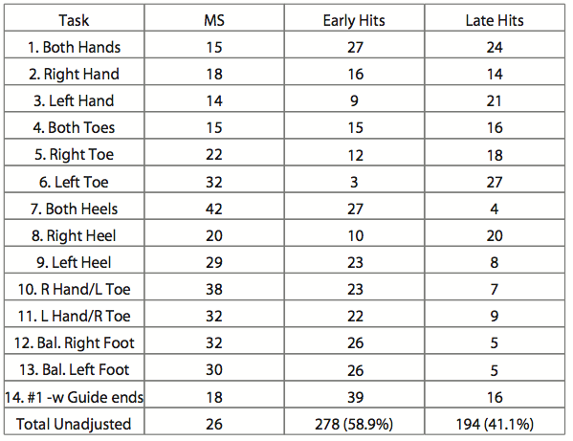
Evaluating the LFA
Look at the difference between task 1 & 14 –It’s much harder to perform with guide sounds
Start with learning the Reference Tone
Notes:
This is an example only. Not everyone’s LFA will look like this! - The first thing to look for is the difference between task 1 and task 14. For most people, task 14 will be a higher score because of the extra distraction of the guide sounds. This will give you an idea as to where to start their difficulty level for their training. When you see higher scores, begin with fewer reps.

Slide 22
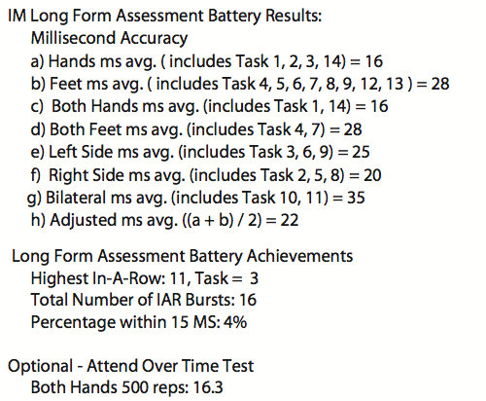
Evaluating the LFA
Hand tasks are easiest for this client – start here!
Introduce foot tasks once client understands guide sounds and is scoring under 100 ms with hands
You may want to re-administer the LFA at session 7 before you add feet!
Bilateral tasks are hardest for the client – wait to introduce these tasks
Notes:
- The first thing to look for is the difference between task 1 and task 14. For most people, task 14 will be a higher score because of the extra distraction of the guide sounds. This will give you an idea as to where to start their difficulty level for their training. When you see higher scores, begin with fewer reps.

Slide 23
Set up a “New File” on IM Pro
Complete 4-day training plan located on the Course Materials Page

Slide 24
NEXT SESSION
Review of Software Features
Review of Definitions and Settings
Evaluate your Long-Form Assessment (LFA)
Determining “Who” to treat and how
Learn when to modify the training
Start thinking about who your first client to train will be

Slide 25
Contact Information
Interactive Metronome, Inc
Toll free: 877-994-6776
Education Support
imcourses@interactivemetronome.com
Technical Support
support@interactivemetronome.com
Clinical Support
clinicaled@interactivemetronome.com
Like us on Facebook!
Follow us on Twitter! @imetronome
Notes:
The F and the T are links to the appropriate pages!

