Slide 1
IM-Home Certification
Presentation by:
April Christopherson, OTR/L
Notes:
Your (participants) PPT includes 16 additional slides detailing the eclinic starting after slide 22 video on the eclinic.

Slide 2
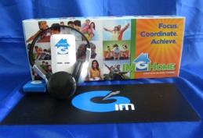
Agenda
Why IM-Home?
What is IM-Home?
Client Selection
Models of Use
Your Responsibilities as an IM-Home Provider
IM-Home Demo Unit for Marketing
*Contact IM to purchase an IM-Home Demo Unit
How to Use the eClinic
Identifying Your Client’s Goals
Assessments
Shifting from Clinic/School to Home
Scheduling your Client’s IM-Home sessions
Motivational Strategies
How to Charge
How to Market

Slide 3
Resources
Marketing Materials
Screening Form with Pricing
What is the Cost of a Changed Life?
Developmental Milestones
What is IM’s Secret Ingredient?

Slide 4
Resources
Set-Up & Equipment Guide
Rating Scales & Rating Comparison
Sensitive Assessment Instruments List
Case History
Scheduling Chart
Achievement Chart
Session Journal
Certificate of Completion

Slide 5
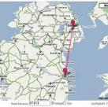
The Problem The Solution
Scheduling
Distance
Money/Insurance
Limited Clinic Time
Maintenance
Busy Lives/Busy Schedule= IM-Home

Slide 6
Notes:
What is IM-Home?

Slide 7
Benefits for the Provider
Manage limited time with your client while still achieving good outcomes
Grow your business while helping more clients
Extends Reach
Builds Volume
Efficient Therapy Management Tool
Sets-Up Clients for Better Overall Outcomes

Slide 8
Client Selection
Opportunities
Travel Issues
High Deductibles
Limited Approved Visits
No Prescription for OT, PT, ST
Degenerative Diseases
Immune Disorders
Athletes
Schools
IM-Home IS NOT for clients who have significant impairments that require cues, hands-on assistance, or face-to-face interaction with the IM Provider to facilitate successful outcomes.
Notes:
In addition to clients we already see in the clinic (using IMPro), these are some key clients to focus on for IMHome use.

Slide 9
Standardized Assessments
Use discipline-specific standardized assessments and academic achievement tests to objectively measure & document change in function.
Notes:
Use assessments pre and post IM Home training, regardless of setting.

Slide 10
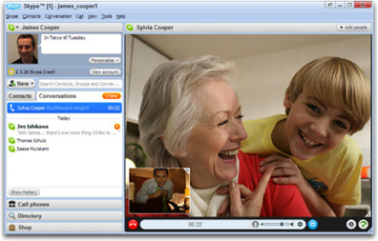
Models of Use
Hybrid: Combination of direct care using IMPro in-clinic & IMHome allows patient to bill insurance part of the time for IM training & address other therapy needs during direct interactions with the professional.
Virtual: Great for those that are good candidates - but are not within reach of an IM Provider; have scheduling or insurance constraints; or will benefit from continued training beyond discharge
Notes:
We are going to talk today about different settings and uses with the IMHome. We will go more in-depth on this later in the presentation.

Slide 11
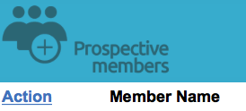
First Steps: Client Enrollment
Enroll your member in the eClinic
You will practice on yourself with the demo unit
For users who order through the IM-Home website online, you simply click “accept” in your eClinic account
Log into eClinic with provider UN & PW
Set-up client’s training plan

Slide 12
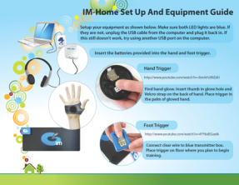
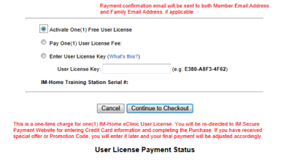
First Steps: Client Instruction
How to set-up the equipment
How to authorize a license

Slide 13
How to Authorize Your License
Video
Notes:
How to Authorize Your License.mp4

Slide 14
Activate One (1) Free User License at Checkout

Slide 15
You are Done When “Paid in Full” Column Indicates “Yes”

Slide 16
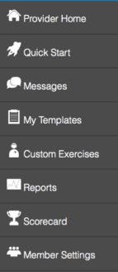
Provider Home Page
Video

Slide 17
Set-Up the Training Plan with Quickstart Menu
Video
Assessment Options
Age
Gender
Workouts
Difficulty Level
Duration
Create or Assign to Member
HIPPA Compliance Option
Notes:
Play Video

Slide 18
IM Training Template Library
Video
Use any of the 60+ predefined templates
Follow IM phases of training to facilitate success
Can be used “as is”
Can be modified as needed for individual client needs (i.e., changes in IM settings, backgrounds, games, etc)
Create your own training plan/template
Templates accessible with IM Universe (both Pro & IM-Home)
Notes:
Templates are categorized by type
Click on the hyperlink or PDF to view more details

Slide 19
IM Templates
Workout Types:
Auditory Only
Auditory to Visual with Progression to Games
All Games
Fall Risk Reduction
Athlete
Custom
Difficulty Levels:
Based on LFA Assessment Score (Both Hands with Guide Sounds)
Easy: LFA<200ms
Medium: LFA=100-200ms
Hard: LFA>100ms

Slide 20
Template Disclaimer
Templates are not set in stone. While templates can successfully be used ‘as is’ for some, others will need to be adapted and changed to meet the needs of individual clients. The following can be settings can be modified:
- Tempo - Difficulty
- Guide Sounds - SRO
- Burst Threshold - Background Screen
- Visual Indicator - Volume

Slide 21
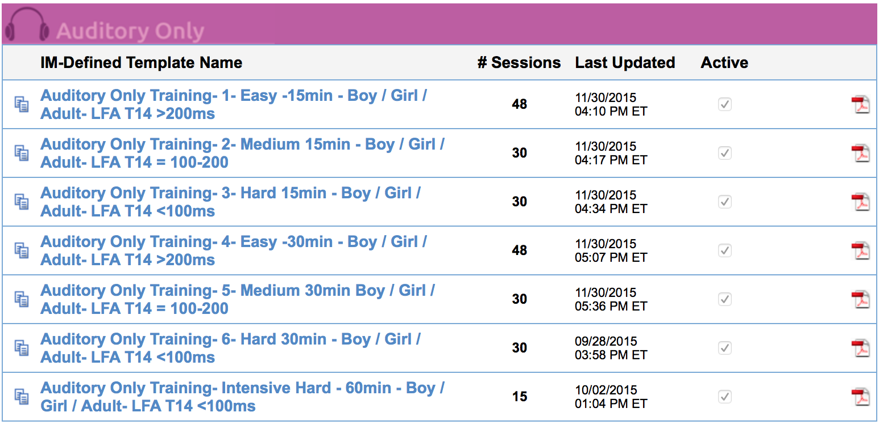
How the Templates look in the eClinic
Template Name
# of sessions
Click on Adobe PDF icon to see the entire template
Click Double Paper icon to Copy an IM Template and modify it
Notes:
Note- Once a template is assigned to you client it can be modified
Video

Slide 22
The eClinic Controls
Video
Notes:
Keep slides 23-39 for step by step instructions

Slide 23
The eClinic Controls
The hammer & magic wand icon controls every task in a session.
Notes:
Video

Slide 24
The eClinic Controls
Arrows- Moves tasks up and down within a session
Notes:
Video

Slide 25
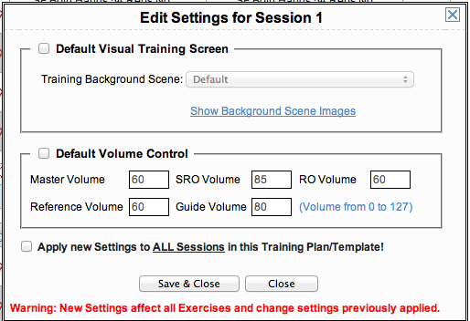
The eClinic Controls
Pencil- Edits volume and visual screen for session
Notes:
Video

Slide 26
The eClinic Controls
3 Papers- Inserts a blank session before or after a session
Notes:
Video

Slide 27
The eClinic Controls
2 papers- Copies a session to a new session

Slide 28
The eClinic Controls
Printer- Prints session

Slide 29
The eClinic Controls
Magnifying glass- Allows you to look at session details

Slide 30
The eClinic Controls
Red ‘X’- Deletes entire session

Slide 31
Lets focus on the Hammer & Magic Wand

Slide 32
The eClinic Controls
Notes:
Video

Slide 33
The eClinic Controls
Notes:
Video

Slide 34
The eClinic Controls
Notes:
Video

Slide 35
The eClinic Controls
Notes:
Video

Slide 36
The eClinic Controls
Notes:
Video

Slide 37
The eClinic Controls
IM Universe has both static & dynamic graphics. Be sure to check out the games!
Notes:
Video

Slide 38
The eClinic Controls
Notes:
Video

Slide 39
The eClinic Controls
Notes:
Video

Slide 40
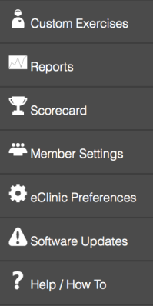
Need Help with the eClinic?
Watch Video Tutorials Online
Located under Help/How To

Slide 41
IM-Home & IM Pro are eClinic Compatible!
Data remains intact whether training in the clinic with IM Pro or at home with IM-Home.

Slide 42
Reports Video
Video
Notes:
Video of reports

Slide 43
Transition to IMHome
When ready to shift from IMPro to IM-Home, set up a meeting with client/caregiver(s)
Review progress to date
Review why you think client is ready to shift to IM-Home
Determine best space within home to complete training
Review what training schedule might be best for your client/caregiver(s)
Help client/caregiver(s) complete the IM-Home scheduling chart before the end of the meeting
Notes:
IM Pro to IMHome transition

Slide 44
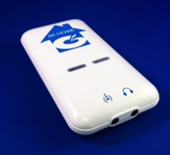
Getting the Most From IM-Home
Notes:
Going into discussion on different settings

Slide 45
Identifying Your Client’s Goals
What are your client’s goals?
How can you facilitate achievement of your client’s goals with IM-Home?
Notes:
Talk about therapy, academic, life, social, future goal areas – these goals may be different than those you’ve worked on in the clinic or classroom.

Slide 46
Case History
Notes:
Use the case history resource to determine personal, academic, rehab, social, and home (ADL) needs/goals

Slide 47
RESOURCE: Pre, Mid & Post Ratings Scale Worksheet
Gauge where your clients are pre, mid and post IM-Home training with Rating Scales:
Social/Emotional
Language
Physical/Motor
Sensory
Attention/Organization
Notes:
One of the great resources you have is the ratings scales!

Slide 48
Sample IM-Home Training Schedule
Notes:
It’s important to train 3-4 times per week at home to get the best results.

Slide 49
Provide Encouragement & Feedback with IM-Home Messaging System
Single Messages
Group Messages
Auto Messages
If training hasn’t been completed in ___ days
After a session # or date
Upon completion of a training plan
Capability to insert emojicons, hyperlinks and more!
Notes:
Emojicons & hyperlink options

Slide 50
Messages
Video
Notes:
Auto messaging, new messaging options

Slide 51
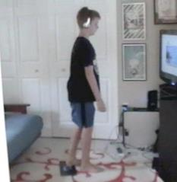
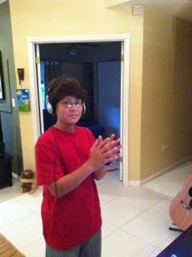
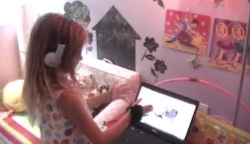
Motivating & Rewarding Young Clients
Notes:
Ideas: Have a box of tools/toys that are only to be used with IMHome training
Set up IMHome in a special area of the home – make it unique to child
Decrease distractions (use a large refrigerator box to decrease visual distractions

Slide 52
Motivating & Rewarding Young Clients
Identify rewards for putting forth effort to complete IM training sessions
Less is more
What is the smallest level of “buy-off”?
Words of encouragement count
Post best ms, # of burst or IAR somewhere child can see
Never use food as a reward
Point/token system towards a larger prize
Treasure box
Do a family weekly reward
Sprinkle in surprises

Slide 53
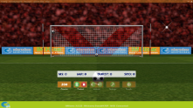
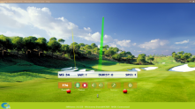
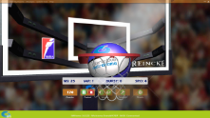
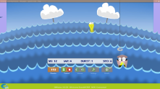
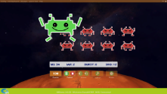
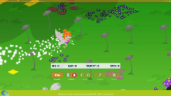
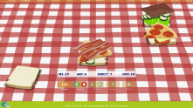
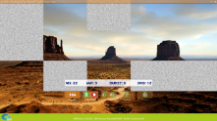
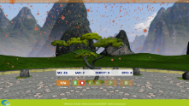
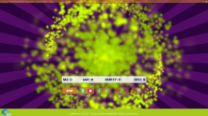
IM Universe Worlds
Notes:
Motivation -

Slide 54
Supporting Parents/Caregivers
Give parents/caregivers guidance & tools for helping child stay on track with training
Help parents/caregivers recognize child’s progress
Review training results & impact on function
Recognize incremental increases in independence
Discuss benefit of future booster IM Home training sessions as child grows and matures
Before next school year/big test
Before a sport season/event

Slide 55
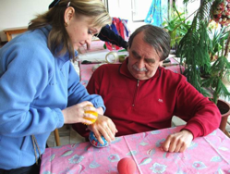
Motivating Adults to Achieve Results
Stay in touch!! Personally or by phone, not just by email or messaging.
Praise for incremental progress - Everyone needs recognition!
Discuss changes in daily function & encourage consistent IM-Home training to achieve goals.
Coordinate with other therapy professionals about the “Big View” Goals

Slide 56
Let’s Get Down to Business!
Notes:
Need a graphic or a picture – no additional words
This slide is the introduction on how to make and keep making a profit using the IMHome!

Slide 57
Profit Examples
Cost Per Session | # of Sessions | Total Cost of IM/ IM-Home Program Consultation | Time it Takes You (sessions all in-clinic) | Time it Takes You (sessions all IM-Home)
$50 | 30 | $1500 | 30 hours | 10-15 hours
$100 | 30 | $3000 | 30 hours | 10-15 hours
$100 | 5 | $500 | *2 hours | *3-5 hours
Equipment Cost
$599 IM-Home Wireless Equipment
$499 IM-Home Wired Equipment
$99 Additional License
**Plus Your Clinical Fees**
Notes:
**total cost analysis – insurance may pay for some/all of the in-clinic time *depends on insurance, benefits, co-pays, limitations
**Remember that with IMPro you are paying for minutes. A client that owns the IMHome can bring it with them for training while working with you in the clinic/school setting.
Discuss package example as a way of reducing overall consultation. 2 hours in clinic for training with client (hands on – insurance likely will pay for this!) and 3-5 hours consultation when client is training in home.

Slide 58
Profit Example – Clinic to Home
IM Services | Patient Type by Function
 | High (3-5 weeks) | Medium (5-8 weeks) | Low (3-5 weeks)
Initial Assessment & Set-up (1 hr, 30 min) | 1 | 1 | 1
Virtual Consultation (15 min) | 5 | 8 | 12
In-Clinic Session (1 hr) | 2 | 4 | 6
Re-Assessment (1 hr) | 1 | 1 | 2
Total Revenue to Clinician | $625 | $900 | $1300
Total Clinician Time Spent with IM-Home | 6 hrs, 45 min | 9 hrs | 13 hrs
Price for IM-Home | $599 | $599 | $599
Total Cost to Patient | $1,224 | $1,499 | $1,899
Cost if All in Clinic | $1,500 | $2,400 | $3,600
Cost Savings to Patient | $276 | $901 | $1,701
Notes:
$625 may not seem like much, but you are getting paid for your time- you are spending less time with the patient & they are still getting the benefit of IM
1. These are patients that you would not have had or would have lost. Extra Money on top of the patient you see in the clinic
2. This revenue could be on top of the revenue you are getting while the patient is coming to see you for other modalities in the clinic
$256 may not seem like a lost of saving to the patient, but as the patient needs more sessions the savings get higher as you can see from the table
This could be beneficial in the maintenance scenario
Why patients are going to want it from a financial perspective – how to close a sale
Where can you , the provider, make your revenue

Slide 59
Profit Example - Virtual
IM Services | Patient Type by Function
 | High (3-5 weeks) | Medium (5-8 weeks) | Low (3-5 weeks)
Initial Virtual Assessment & Set-up (1 hr, 30 min) | 1 | 1 | 1
Virtual Consultation (15 min) | 5 | 8 | 12
Additional Distance Consult (15 min) | 2 | 4 | 6
Virtual Re-Assessment (1 hr) | 1 | 1 | 2
Total Revenue to Clinician | $425 | $550 | $800
Total Clinician Time Spent with IM-Home | 4 hrs, 15 min | 5 hrs, 30 min | 8 hrs
Price for IM-Home | $599 | $599 | $599
Total Cost to Patient | $1,024 | $1,149 | $1,399
Cost if All in Clinic | $1,500 | $2,400 | $3,600
Cost Savings to Patient | $476 | $1,251 | $2,201
Notes:
Notice what is different in this model- your in-clinic sessions because 15 minute additional consults which means:
More savings for the patients
More time savings for you

Slide 60
Achieving Clinical Success & Profitability On-Demand Webinar
Target client population
Options for providing training to client
How to manage and track costs
How to price IM-Home
How to bill, including cash and insurance billing
Notes:
If clinicians want more information on profitability take the webinar

Slide 61
Marketing IM-Home
Demo IM-Home to current clients
*Contact IM to purchase an IM-Home Demo Unit
Hold free screenings for new clients
Package IM-Home with other therapy modalities
Resources we have created for you:
Brochures: Pediatric & Adult
What is the cost of a Changed Life?
Developmental Milestones
What is IM’s Secret Ingredient?
Screening Form with Pricing
Ads
Notes:
An important part of business development is Marketing. Use the online resources – FREE! – to assist in marketing!!

Slide 62
Business Development Tool Kit
Watch Marketing 101 videos and learn what it takes to build a successful practice.
Promote your IM services with professionally made video clips and news clips. All you have to do is cut and paste the code into your website. It’s easy and will be a sure-fire way to get clients into your door, so you can help them make the gains they dream about.
Make your mark on the web! Choose from wallpapers to decorate your desktop, banners to advertise on your website and email campaigns to drive people to your door.
Check out the numerous flyers, brochures, postcards, referral cards and banners to hand out or display at a tradeshow. Choose from IM stock images and logos to customize your marketing pieces.
Social media provides an opportunity to reach clients and professionals on a personal level. It’s time to get your business on the social sphere so you can communicate your mission in this manner. Get started today.

Slide 63
Required Homework
Log into the eClinic with your Provider UN & PW
If you do not know it, email support@interactivemetronome.com to request it
Follow Quickstart Menu to establish yourself as an IM-Home member (you will give yourself a different UN & PW than the one you use as “Provider.” You are setting yourself up as a client, so you will assign yourself another UN and PW as a “client.”
Select IM-Home Certification Training Plan in the eClinic under My Templates
Set- up demo IM-Home unit & authorize free license *Note if you do not have a demo unit, you may use your IM Pro Unit with the eClinic. Please contact support@interactivemetronome.com for assistance
Complete 4 brief sessions of IM Home training (1 per day for 4 days) until you have completed the entire training plan. (COMPLETION IS MONITORED AND REQUIRED FOR IM-HOME CERTIFICATION AND CEUs)

Slide 64
Homework (Required for IM-Home Certification)
Log back into eClinic as a “Provider” this time using your Provider UN & PW.
While you are logged into eClinic as a Provider, test the following functions:
View reports (your session data as a “client” can be viewed)
Send a message to yourself (the client)
Explore the training templates.
Select & modify a training plan
Change background screens, games, reps, difficulty, tempo…
Add exercises to training plan, create custom exercises, change a client’s training template, create your own training template, …

Slide 65
Post-Test & Course Evaluation
FINAL STEPS TO IM-HOME CERTIFICATION
Upon completion of the mandatory 4 sessions of IM Home training & exploring the eClinic, take the written post-test (a link for the online test has been provided to you in the email you received to take this course).
Complete the course evaluation.
A certificate of completion will be emailed to you.
Congratulations!! The IM Home Provider designation will be placed next to your name in the Provider Locator.

